Slide 1



How Do Weather Conditions Influence Traffic Flow in A²?
Katie Forrest & Mya Gibson

Slide 2



APIs Used
TomTom Api
We used the TomTom API to find traffic flow in Ann Arbor by measuring:
traffic speed
travel time
road closures
confidence of predicted traffic conditions
OpenWeather API
We used the OpenWeather API to find weather conditions by measuring:
current temperature
daily maximum temperature
daily minimum temperature
weather conditions (sunny, cloudy, etc.)
specified descriptions (light rain, light clouds, etc.)
Notes:
Mya

Slide 3
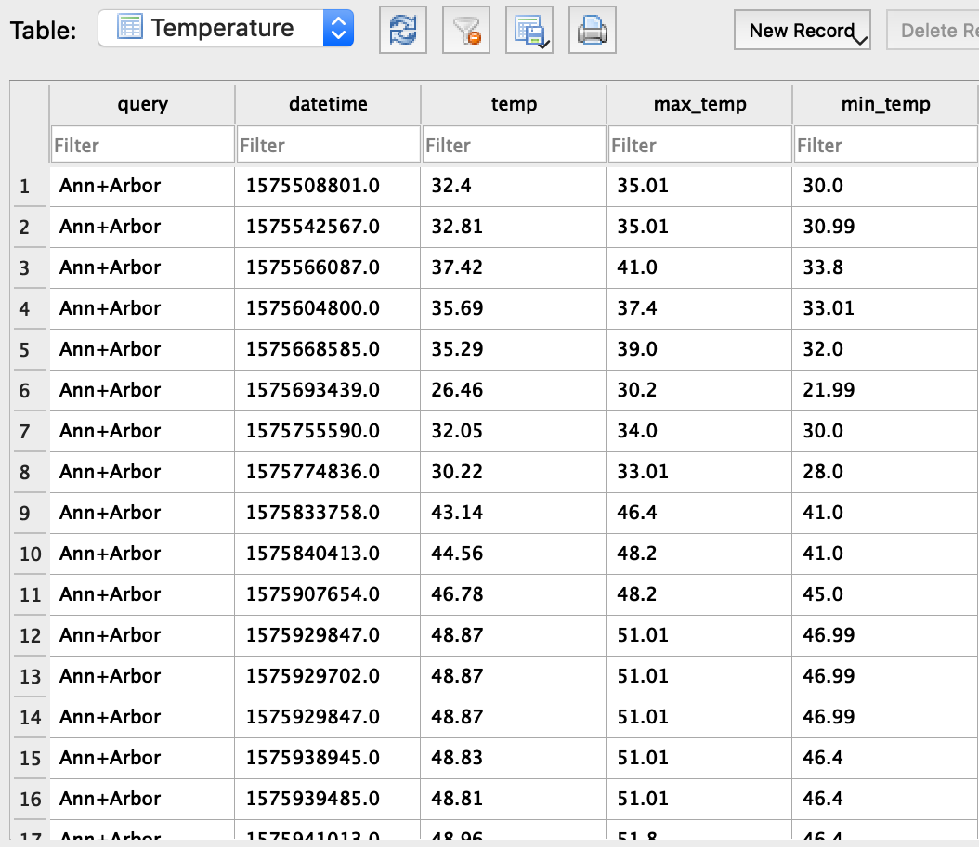
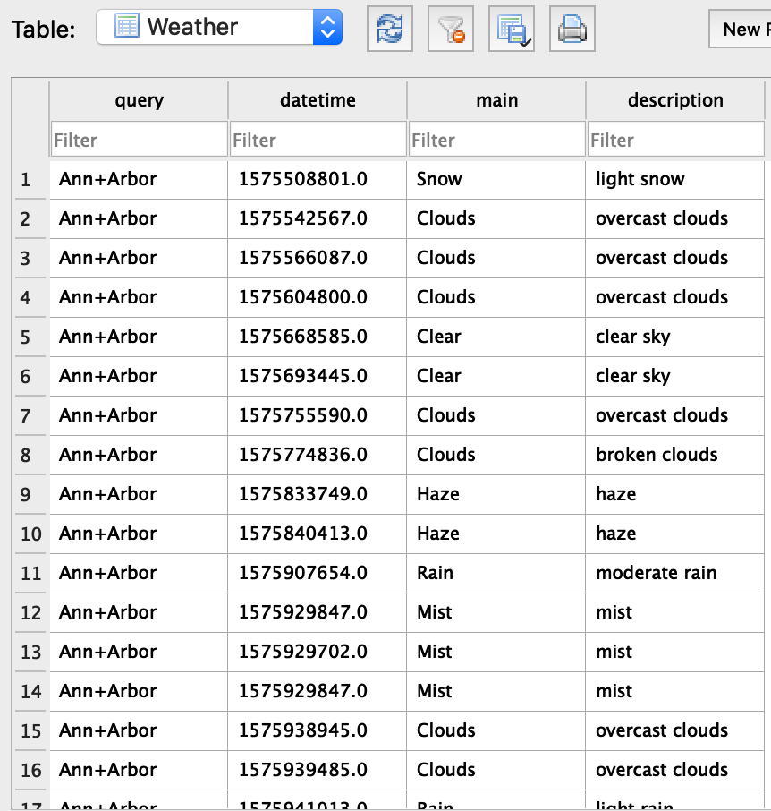

Tables Created For Databases in SQLite3
We created four tables, which all recorded a unique datetime to ensure no duplicate data was collected. Each time all four tables were run, only 12 lines of total data were collected across all tables. The Weather and Temperature tables shared a key.
Notes:
Katie

Slide 4

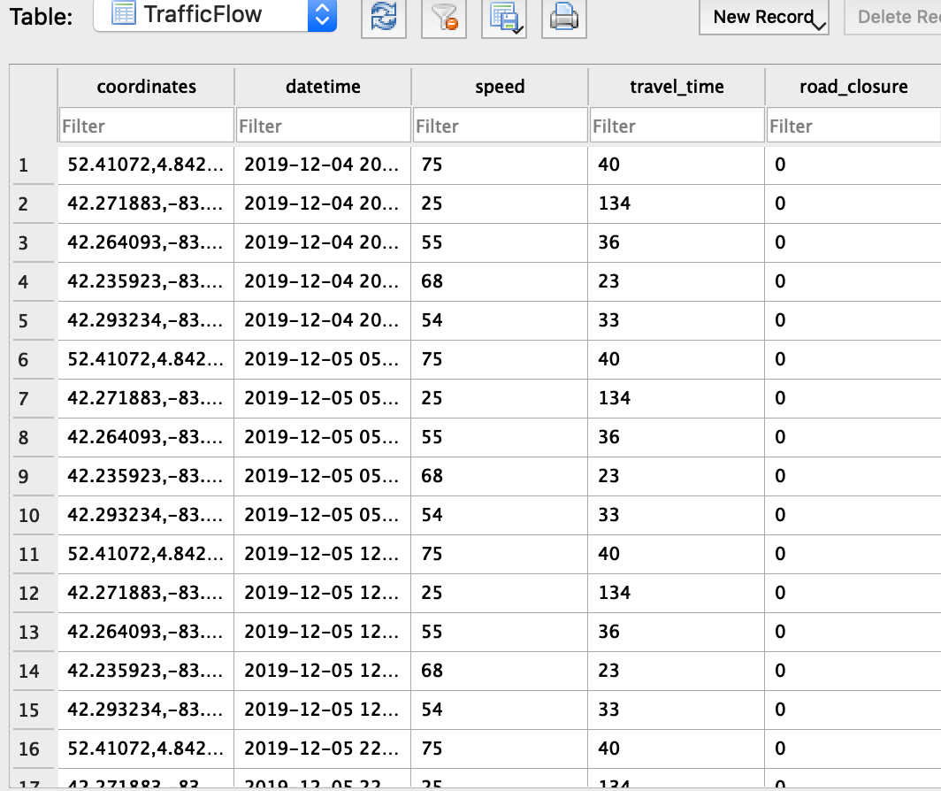
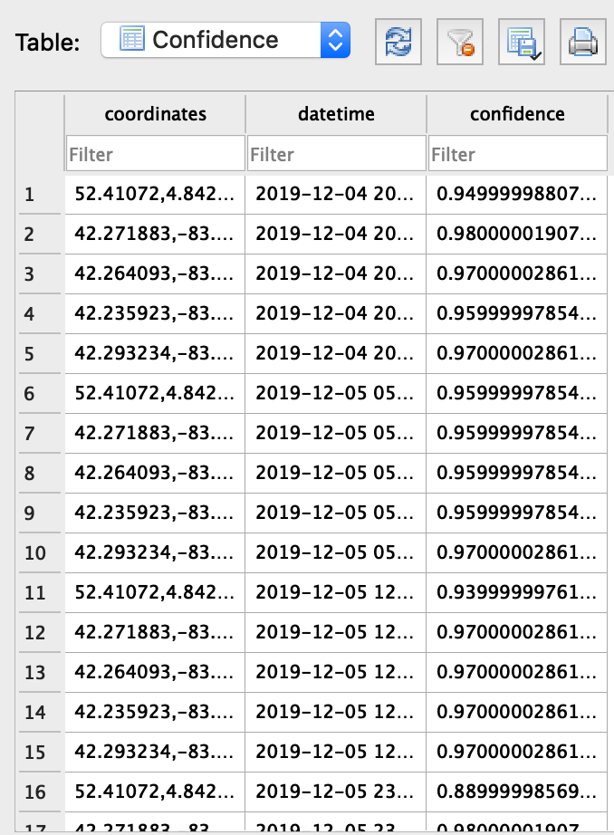
Tables Created For Database Continued
The TrafficFlow and Confidence tables also shared a key and used bounding boxes with 5 different sets of coordinates to define the area that they would record traffic data.
Notes:
Katie

Slide 5

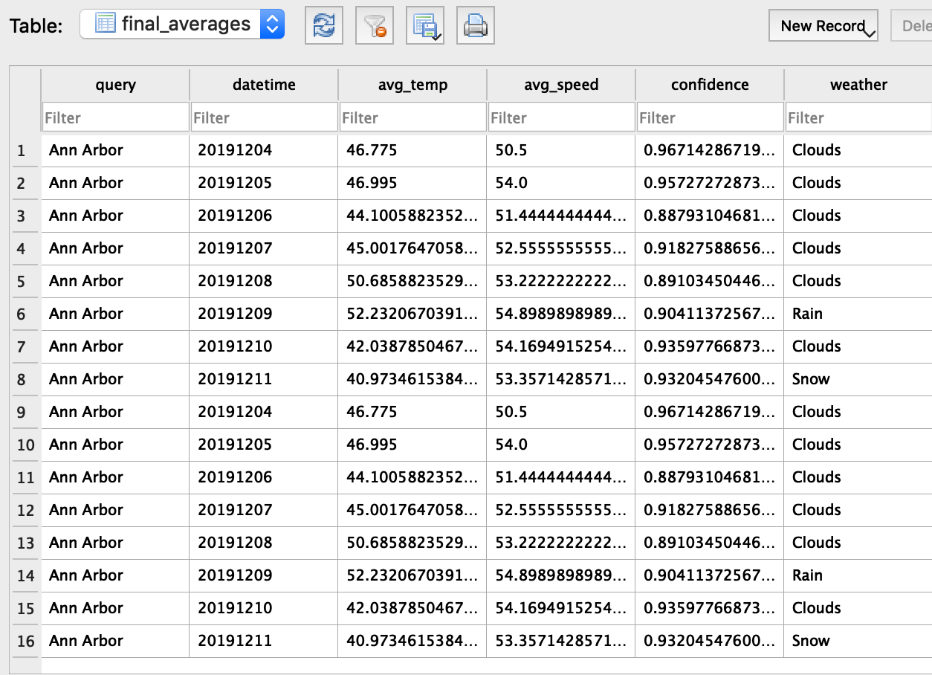
Calculations from Data
After collecting that data, we calculated the average confidence of traffic conditions, average speed, average temperature and average weather condition. The calculated data was written to the text file.
Time stamps for weather data and traffic data were collected in different formats, so we converted those formats and then used the timestamp to the day, not the hour or second, in order to ensure we would get matches when we did a database join.
Notes:
Katie

Slide 6
Visualizations
Using Matplotlib

Slide 7
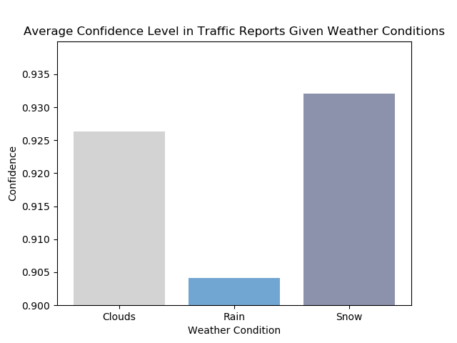
Average Confidence Level in Traffic Reports Given Weather Conditions
Visualization 1 (Bar Graph) showed that the confidence in traffic reports was highest when snowing (93%), second highest when cloudy (92.6%), and significantly low when raining (90.5%).
Notes:
Mya

Slide 8
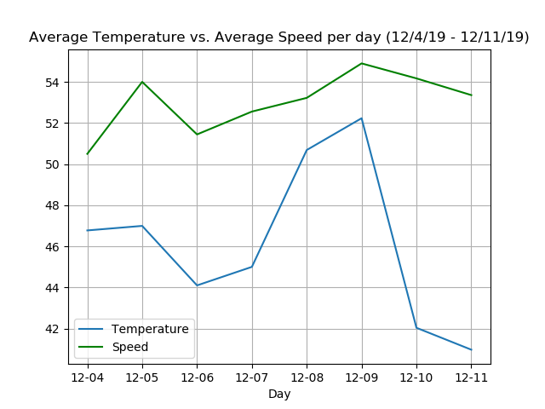


Average Temperature vs. Average Speed Per Day (12/4/19-12/11/19)
Visualization 2 (Double Line Graph) demonstrated a direct relationship between temperature and average speed. When the temperature rose, the speed increased, and vice versa.
Notes:
Mya

Slide 9
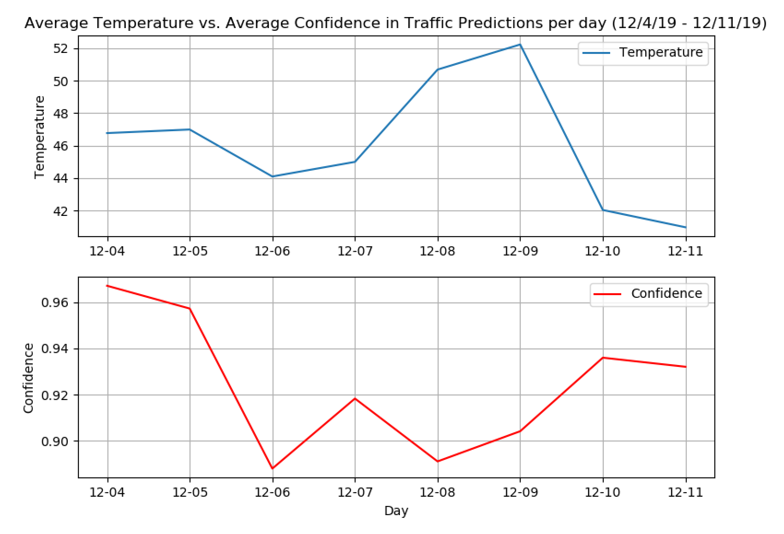
Average Temperature vs. Average Confidence per day (12/4/19-12/11/19)
Visualization 3 (Subplot Line Graphs) showed that, on average, when the temperature was higher, the average confidence in traffic predictions was lower.
Notes:
Mya

Slide 10
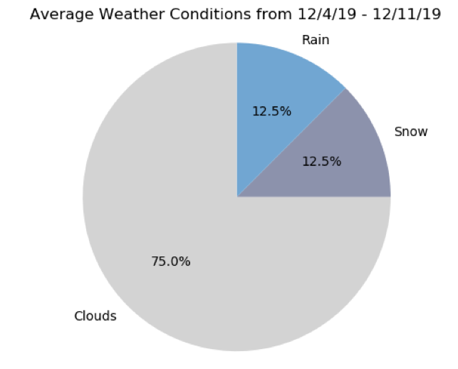
Average Temperature vs. Average Speed Per Day (12/4/19-12/11/19)
Visualization 4 (Pie Chart) showed that 75% of the time, the weather was reported to be cloudy, 12.5% rain, and the remaining 12.5% to be snow.
Notes:
Mya

Slide 11
Problems During the Project
Problem #1: Unable to retrieve past year’s live traffic & live incident data due to API restrictions
Problem #2: Converting between regular latitude longitude to World Geodectic System (1984) for bounding box.
Problem #3: Collected timestamps from traffic data in human-readable time, but timestamps from weather data in unix epoch time, while recording hours + sec.
Problem #4: Weather description data is not numerical.
Problem #5: Visualization #3 y-axis ranges too different.
Problem #6: X-axis ticks were not showing the first date that we started recording data, causing scale to be off
Solution: Moved forward only using data from specified dates
Solution: Found an online converter so we could ensure we were inputting the data into the code and communicating with the API correctly.
Solution: Convert the format of the timestamps. Then limited the timestamp to the hour in order to get matches when we joined the data
Solution: To calculate the average, used a counter.
Solution: Used a sub-plot line graph instead.
Solution: Created an empty string placeholder.
Notes:
Katie: problems 1-3
Mya: problems 4-6

